Slide 1
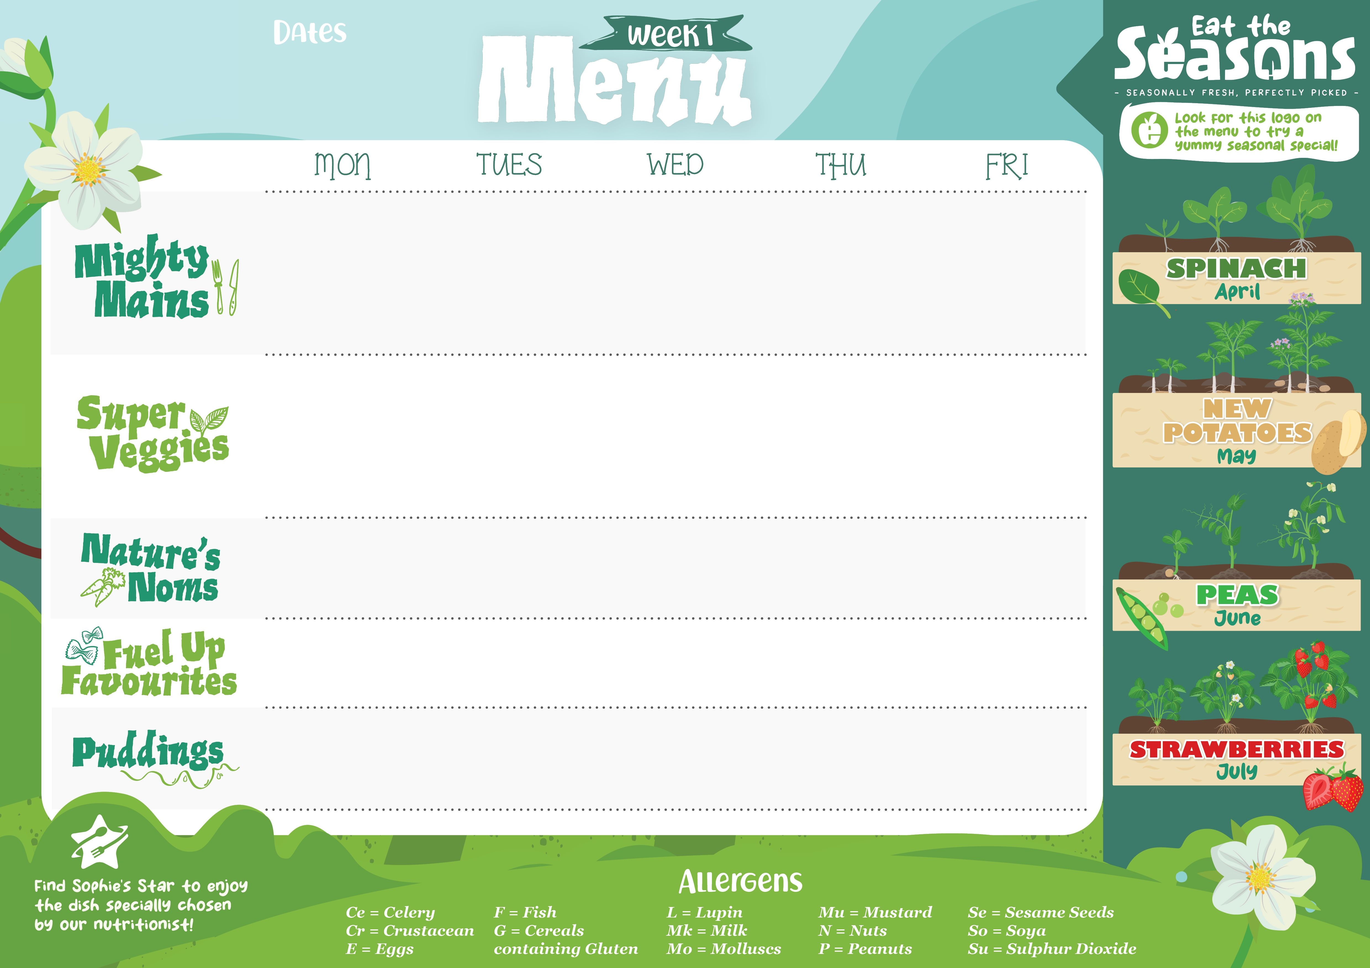
Week commencing
21st April, 12th May, 9th June and 30th June
Chef’s soup served everyday and fresh bread served twice a week
Mild & Creamy Chicken Balti with Peppers & Spinach (None) | Traditional Beef Lasagne with a Cheesy Crust (G,E,Mk) Or Beef Bolognaise and Gluten Free Pasta | Butchers Select Pork & Leek Sausages with Caramelised Red Onion Gravy (G,Su) Gluten Free sausages available | Honey & BBQ Glazed Chicken (None) | Margherita Focaccia Pizza (G,E,Mk)
Potato and Vegetable Creamy Curry (None) | Ratatouille Vegetable & Penne Pasta Bake with Basil (G,Mk) | Glamorgan Sausages with Caramelised Red Onion Gravy (G, E, Mk, Mu, So, Su) | BBQ Quorn and Vegetable Wraps (G) | Roasted Vegetable and Basil Focaccia Pizza (G,E,Mk)
Roasted Vegetables | Chef’s Mixed Summer Salad | Steamed Broccoli | Peas Roasted Tomatoes | Sweetcorn
Brown Rice | Accent Focaccia (G) | Mashed Potato | Baked Oven Chips
Summer Berry Eton Mess Pots (Mk,E) | Lemon and Thyme Sponge (G,E,So) | White Chocolate Chip & Raspberry Cookie (G,E,Mk,So) | Poached Pear Conde Pots (Mk) | Dorset Apple Cake (G,E,Mk)
Jacket potatoes, salad bar, fresh fruit and free from puddings available daily.

Slide 2


Week commencing
28th April,19th May, 16th June and 7th July
Chefs soup served everyday and fresh bread served twice a week
Tandoori Chicken with Mint & Cucumber Raita (Ce,Mk,So) | Italian Beef Meatballs in a Rich Tomato & Basil Sauce served with Penne (G,Su,Ce) | Roast Chicken Breast, Stuffing (G) & Gravy | Mexican Beef Chilli Con Carne, Smashed Avocado, Sour Cream, Salsa & Tortilla Chips (G,Mk,Mu) | Fish Fingers Or Baked Fish (G,F) with Chunky Tartare Sauce (E) & Lemon Wedges
Tandoori Aubergine, Tarka Dhal & Naan Bread (Ce,G,So,Mk) | Macaroni Cheese Bake with Crunchy Garlic Crumble Topping (G,E,Mk,So) | One Pot Sausage & Vegetable Casserole (G,Ce) | Mexican Buffalo Bean Chilli Smashed Avocado, Sour Cream, Salsa & Tortilla Chips (G,E,Mk,Mu) | Seasonal Summer Hero “Leaf Spinach” Spinach & Feta Cheese Spanakopita Filo Pie (G,E,Mk)
Skin on Roasted Butternut Squash Roasted Cauliflower | Steamed Broccoli Roasted Leeks | Parsley Carrots Sauteed Spring Greens | Roasted Peppers & Corn Green Beans | Garden Peas Baked Beans
Turmeric Rice | Garlic Focaccia (G) | Skin on Roast Potatoes | Steamed Rice | Baked Oven Chips
Blueberry & Lemon Cheesecake Pots (G,E,Mk) | Carrot Cake Cookie (G,E,Mk) | Peach Melba Crumble Pots (G,Mk) | Chocolate Cake with Chocolate Orange Frosting (G,E,Mk,So) | Strawberry & Coconut Chia Seed Pudding Pot (So)
Jacket potatoes, salad bar, fresh fruit free and from puddings available daily.

Slide 3

Week commencing
5th May, 2nd June and 23rd June
Traditional Beef Bolognaise (None) | Tender Beef & Summer Vegetable Stew (G) | Roast Norfolk Turkey with Cranberry Stuffing (G) & Gravy | Katsu Chicken with Curry Sauce & Pickled Asian Vegetables (G,E,So,Su) | Fish Fingers (G,F) with Chunky Tartare Sauce (E) & Lemon Wedges
Vegetable & Lentil Bolognaise (G,So) | Wonky Summer Vegetable & White Bean Stew (G,So) | Stuffed Mushrooms with Creamy Leeks & Mature Cheddar (G,Mk,So) | Katsu Tofu with Curry Sauce & Pickled Asian Vegetables (G,E,So,Su) | Vegetable Spring Rolls with Sweet & Sour Sauce (G,So)
Sauteed Courgettes | Sticky Honey Carrots Broccoli | Braised Red Cabbage (G) Minted Carrots | Sauteed Spring Greens Naked Slaw | Garden Peas Baked Beans
Penne Pasta (G) | Crushed Baby Potatoes | Thyme Roast Potatoes | Steamed Rice | Baked Oven Chips
Apple & Raspberry Fool Pots (Mk) | Seasonal Summer Hero “Leaf Spinach” Moss Cake with Cornflake Frosting (G,E,Mk) | Lemon Drizzle Sponge (G,E,Mk) | Messy Berries Pots with Greek Yoghurt & Smashed Meringue (E,Mk,So) | Pineapple Upside Down Cake with Custard (G,E,Mk,So,Su)
Chefs soup served everyday and fresh bread served twice a week
Jacket potatoes, salad bar, fresh fruit, and free from puddings available daily.

