Slide 1
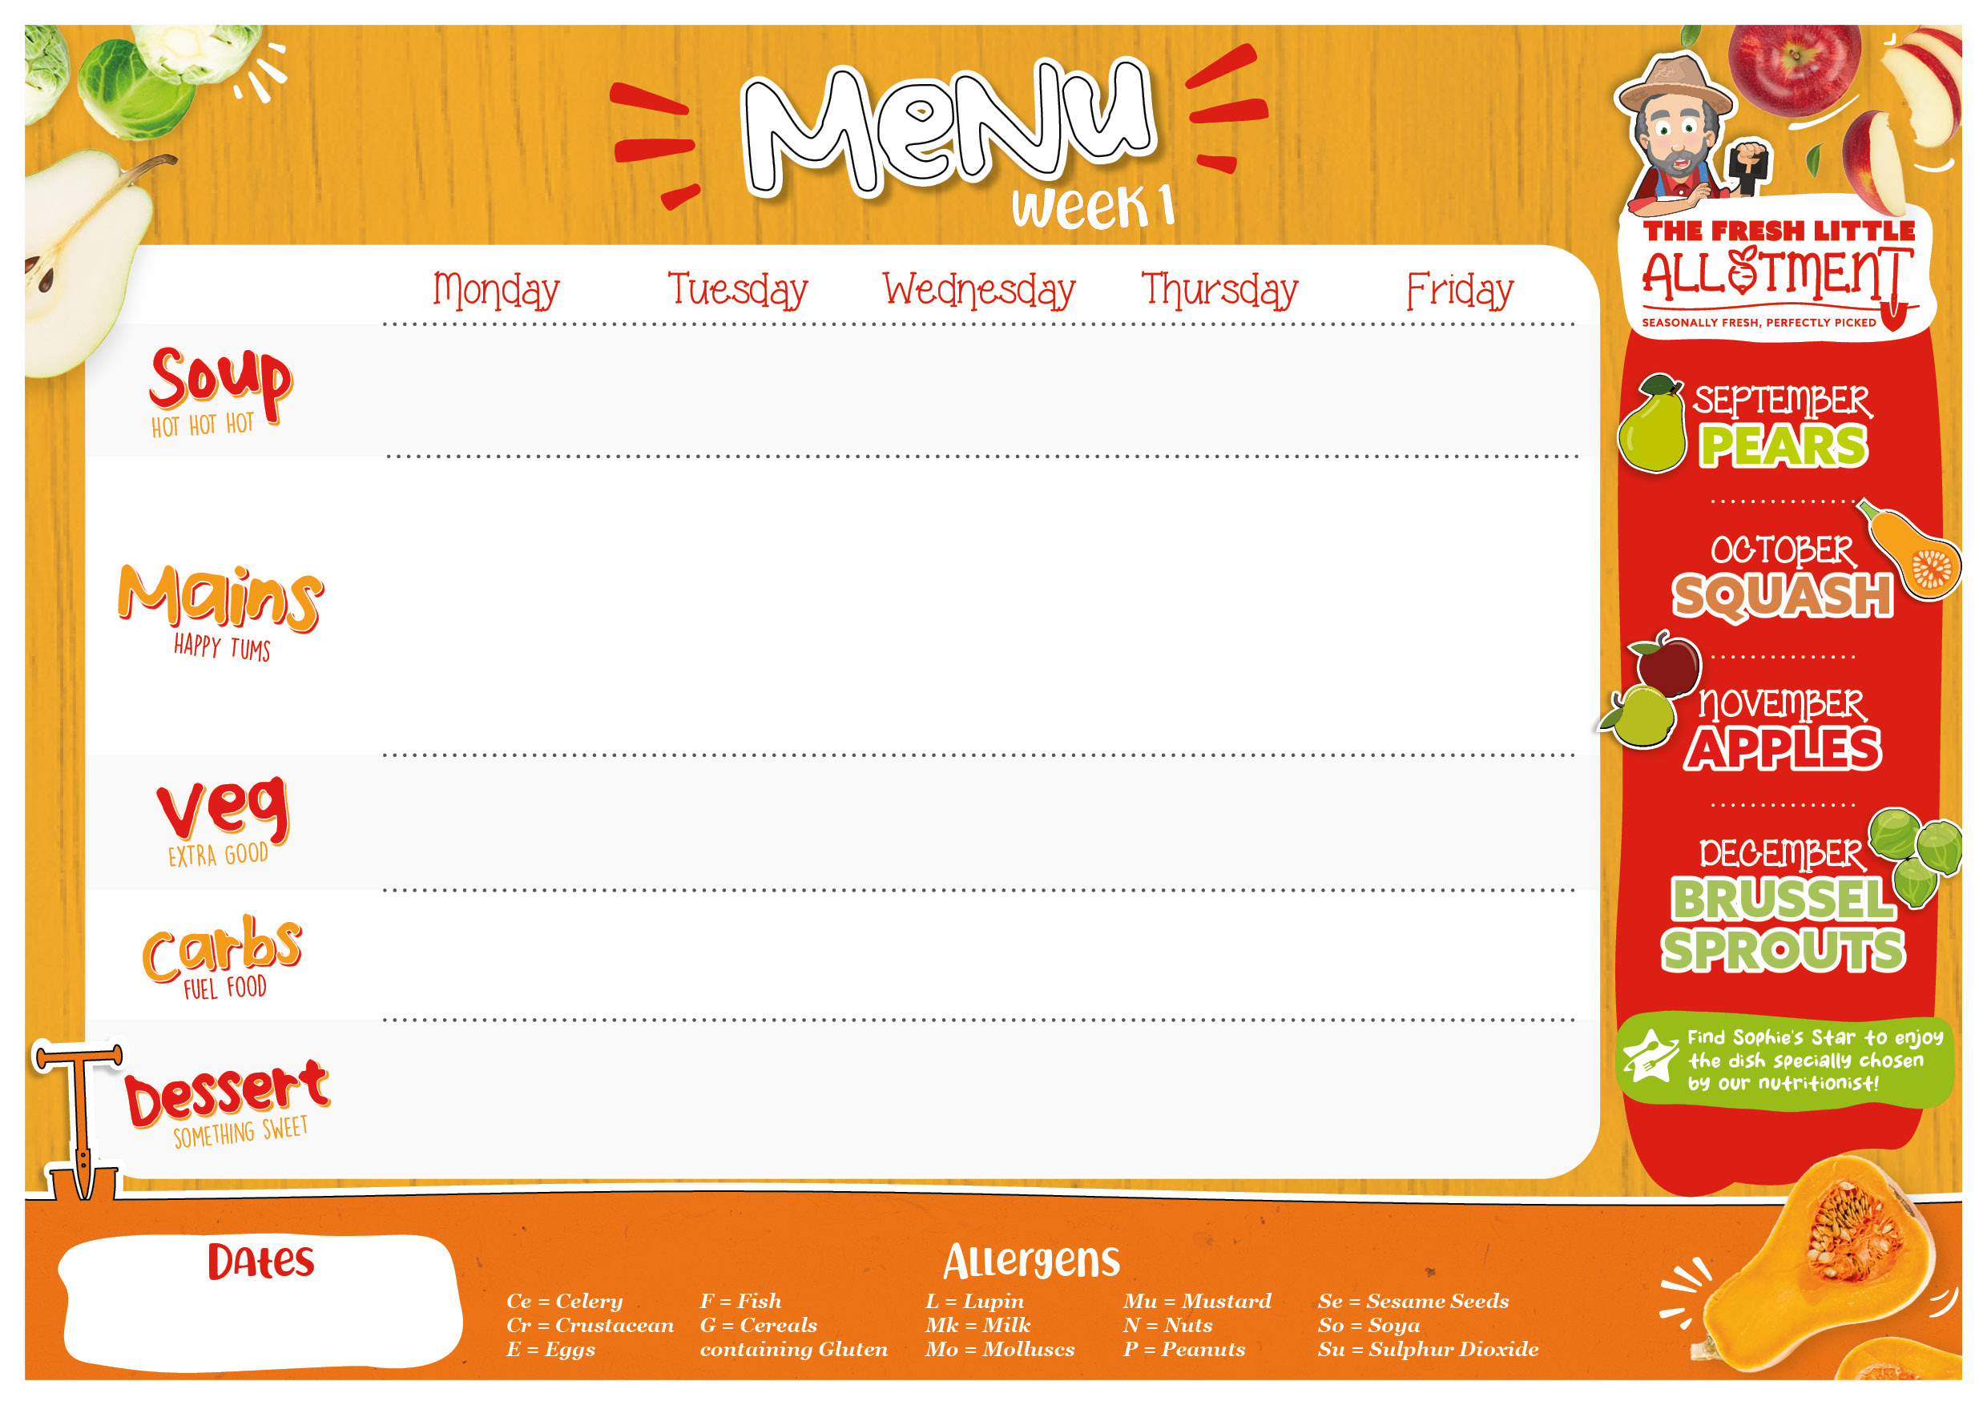

Allergen alternatives offered daily, please ask kitchen staff for more details.
Roasted Tomato & Oregano (Mk) | Balti Spinach & Lentil Soup (G) | Tuscan Vegetable Bean & Minestrone (G,Ce) | Seasonal Autumn Hero – Butternut Squash – Roasted Autumn Squash and Rosemary | Chefs Seasonal Soup Kitchen
Chicken Katsu Curry (G,So) | Greek Lamb Moussaka topped with Crumbled Feta (G,Mk) | Honey Roast Gammon with Gravy | Mexican Pork Chilli Con Carne Smashed Avocado, Sour Cream, Salsa and Tortilla Chips (So,Mu,Mk) | Fish Fingers (G,F) with Chunky Tartare Sauce (E) and Lemon Wedges
Quorn Katsu Curry (G,E,Mk,So) | VEGAN Plant Based Red Lentil & Aubergine Moussaka (G,So) | Cheesy Cauliflower Steak with Tomato & Basil Sauce (G,Mk,E) | Mexican Buffalo Bean Chilli Smashed Avocado, Sour Cream, Salsa and Tortilla Chips (So,Mu,Mk) | VEGAN Chinese Vegetable Spring Rolls with Sweet & Sour Sauce (G,So)
Charred Corn on the Cob Roasted Mediterranean Vegetables | Baked Courgettes with Lemon & Garlic Tomato & Rocket Salad (Su) | Sticky Honey Carrots Broccoli | Sauteed Autumn Greens Jalapeno Slaw (Su,Mu,E) | Garden Peas Baked Beans
Coconut Rice (Su) | Paprika Parmentier Potatoes | Skin on Roasties | White & Wholegrain Rice | Oven Baked Chips
Seasonal Autumn Hero - Apples - Dutch Apple Cake (G,Mk,E) with Custard (G,So,Mk,E) | Fresh Cut Fruit and Yoghurt Pots | Seeded Frosted Carrot Cake (G,Mk,E) | Fresh Cut Fruit and Yoghurt Pots | Vanilla and Black Cherry Sponge Custard Sauce (Su,Mk)
1st Sept, 22nd Sept,
13th Oct, 17th Nov, 8th Dec

Slide 2

Allergen alternatives offered daily, please ask kitchen staff for more details.
Carrot, Orange & Coriander (G) | Spiced Tomato & Red Lentil (G) | Cannellini White Bean, Spinach & Chive (Mk) | Parsnip & Cumin (G) | Chefs Seasonal Soup Kitchen
Succulent Yoghurt Marinated Tandoori Chicken with Cucumber, Mint & Red Onion Salad (So,Mk,Ce) | Traditional Slow Cooked Italian Pork Tomato Lasagne (G,Mk,E) | Cowboy Pie (G,Su,Ce) | Roasted Chicken with Fire Roasted Pepper, Spinach Tomato Sauce & Gnocchi (G,So,Mu,Mk,E) | Battered Fish Chunky Tartare Sauce & Lemon Wedges (G,F,E)
VEGAN Tandoori Cauliflower with Tarka Dhal (G,Ce) | Creamy Garlic, Leek, Spinach, Macaroni Cheese (G,Mu,Mk) | Quorn Sausage Cowboy Pie (G,Ce) | Baked Gnocchi in a Roasted Vegetable Tomato Sauce Topped with Melting Mozzarella (G,So,Mu,Mk,E) | VEGAN Home- made Fishless Fingers, with Vegan Mayonnaise & Lemon (G,So)
Roasted Sweetcorn Sautéed Leeks | Steamed Broccoli Accent House Salad (Su,Mu) | Steamed Green Beans Thyme Roasted Carrot and Beetroot | Rocket and Radish Salad Sautéed Savoy Cabbage | Garden Peas Baked Beans
White & Wholegrain Cardamom Rice Mini Naan Bread (G) | Garlic Focaccia (G,Mk) | Creamy Mash | Home Made Garlic Bread (G,Mk) | Baked Oven Chips
Classic Jam Sponge Custard (G,So,Mk,E) | Fresh Cut Fruit and Yoghurt Pots | Fruity Vegan Jelly Pots | Fresh Cut Fruit and Yoghurt Pots | Winter Berry Cheesecake Pots (G,Mk)
8th Sept, 29th Sept,
3rd Nov, 24th Nov

Slide 3

Allergen alternatives offered daily, please ask kitchen staff for more details.
Sweet Potato, Coconut & Chilli (Ce) | Yellow Split Pea, Chickpea & Coriander (G) | Cauliflower, Cheddar Cheese, Chive (G,Mk) | Winter Vegetable & Butterbean | Chefs Seasonal Soup Kitchen
Beef Burger (G,So,Se,Su) | Mexican Lamb Chilli with Red Onion and Tomato Salsa with a Soft Tortilla (G) | Cumberland Sausages with Gravy (G,Su) Caramelised Balsamic Onion Chutney (Su,Mu) | Shepherds Pie (Ce) | Fish Fingers (G,F) with Chunky Tartare Sauce (E) and Lemon Wedges
VEGAN Crispy Burger with Vegan Mayo, Iceberg Lettuce (G,Se) | VEGAN Red & Black Bean Eat Curious Chilli with Red Onion & Tomato Salsa with a Soft Tortilla (G) | VEGAN Plant Based Sausages with Gravy (G) Caramelised Balsamic Onion Chutney (Su,Mu) | Veggie Mince Cottage Pie (So,Ce) | Seasonal Autumn Hero – Squash – Accent Signature “Squashage” Roll (G,Mk,E) with Herby Gravy
Roasted Cauliflower Five Spiced Corn Cob | Garden Salad Steamed Broccoli | Steamed Broccoli Honey Roasted Parsnip | Smashed Swede & Carrot Steamed Broccoli | Garden Peas Baked Beans
Hand Cut Wedges | White and Wholegrain Rice | Crushed Potato With Spring Onion |  | Baked Oven Chips
Seasonal Autumn Hero – Apples – Apple & Raspberry Fool Pots (Mk) | Fresh Cut Fruit and Yoghurt Pots | Lemon & Lime Drizzle Cake (G,E) | Fresh Cut Fruit and Yoghurt Pots | Seasonal Autumn Hero – Apples – Apple and Sultana Oat Crumble with Vanilla Sauce (G,So,Mk,E)
15th Sept, 6th Oct,
10th Nov, 1st Dec

